Slide 1


Remote Procedure Call
SE3331-1 (2022 Fall)
IPADS, Shanghai Jiao Tong University
https://www.sjtu.edu.cn
Credits: Rong Chen@IPADS

Slide 2
Distributed system that support large-scale websites
Large-scale websites are composed of different distributed systems
Request processing, data storage
Caching server
Caching server
Caching server
…
Caching
Caching
Caching
Distributed caching
Database server
Database server
CDN
Users
Application #1
generate the page
Database
user, price
…
Database
user, price
Application server
Distributed database
Internet
Load
Balance
Application #2
add the order
File server
File server
File server
File:
image
File:
image
…
File:
image
Application server
…
…
Message queue
Distributed file system

Slide 3
Example: extend a single-node filesystem to a distributed one
File System更加适合于管理单机disk
Large-scale websites are composed of different distributed systems
Request processing, data storage
How each system communicates?
Caching server
Caching server
Caching server
…
Caching
Caching
Caching
Distributed caching
Database server
Database server
CDN
Users
Application #1
generate the page
Database
user, price
…
Database
user, price
Application server
Distributed database
Internet
Load
Balance
Application #2
add the order
File server
File server
File server
File:
image
File:
image
…
File:
image
Application server
…
…
Message queue
Distributed file system

Slide 4
Remote Procedure Call (RPC)
“Remote procedure calls (RPC) appear to be a useful paradigm.”
— Birrel & Nelson, 1984
Andrew Birrell, Bruce Nelson, “Implementing Remote Procedure Calls”. ACM Transactions on Computer Systems (TOCS), 2(1), 1984

Slide 5
Problems with the Sockets API
The sockets interface forces a read/write mechanism
Read(), Write(), sendmsg(), etc
Programming is often easier with a functional interface
To make distributed computing look more like centralized computing
Goal of RPC:
It should appear to the programmer that a normal call is taking place
面向单机编程，面向分布式运行

Slide 6



RPC: Remote Procedure Call
Allow a procedure to execute in another address space without coding the details for the remote interaction
RPC History
Idea goes back in 1976
Sun's RPC: first popular implementation on Unix
Used as the basis for NFS
Many modern RPC frameworks: gRPC, bRPC, etc.
RMI (Remote Method Invocation)
Object-oriented version of RPC, e.g. in Java(内嵌在JAVA中)

Slide 7
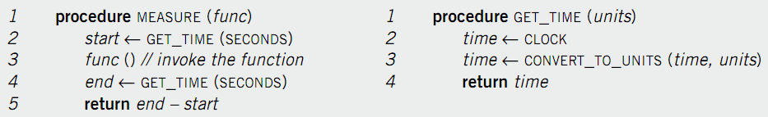
Example of RPC
The implementation of GET_TIME.
Suppose we want to measure the execution time of func()
Assumption:
Only the server has the implementation of GET_TIME
How can the client call server’s GET_TIME?

Slide 8

Call GET_TIME in a single machine case
GET_TIME
func()
GET_TIME
Client

Slide 9
Single-machine call vs. distributed call（RPC）
Call(get_time)
GET_TIME
func()
Client
Call(get_time)
GET_TIME
Server

Slide 10
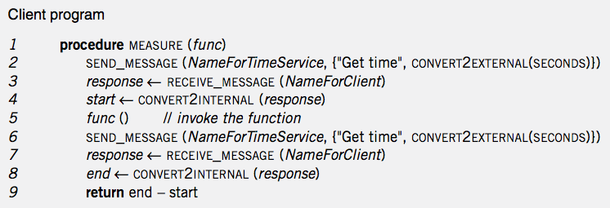
Handwritten code: client
Call(get_time)
Local
func()
Client
Call(get_time)
“Get Time”:一个字段名,convert2External:将本地数据转化为网络传输格式
(如Bytes),convert2Internal函数将server传输过来的数据转化为本地格式，
因为client与server使用的语言以及数据格式可能不同，
所以需要转换，一般以字节码形式传输
RPC

Slide 11
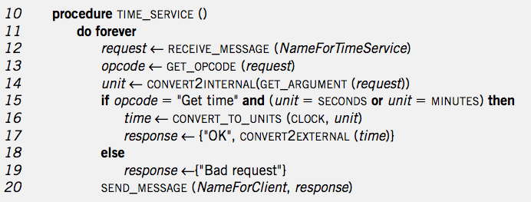
Handwritten code: server
GET_TIME
TIME_SERVICE
Client
Server

Slide 12
RPC simplifies the implementation of remote calls
Abstracts away the common parts with stub
Provided in
RPC’s stub

Slide 13
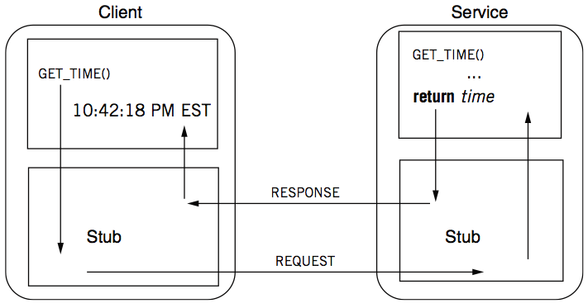
RPC: a complete calling process
stub：将c/S之间的通信部分给屏蔽掉，
使得对于上层程序而言只是相当于调用
了一个本地的函数，而与server的通信
有stub来完成。从而理论上实现了
“面向单机编程，面向分布式运行”。

Slide 14
RPC stub
Client stub
Put the arguments into a request
Send the request to the server
Wait for a response
Service stub
Wait for a message
Get the parameters from the request
Call a procedure according to the parameters (e.g. GET_TIME)
Put the result into a response
Send the response to the client
Stub: hide communication details from up-level code, so that up-level code does not change.

Slide 15
Client Program using RPC
procedure MEASURE (func)
start <- GET_TIME(SECONDS)
func()
end <- GET_TIME(SECONDS)
return end - start
Note: code is not changed comparing
with the single-machine case
This is the stub of client
procedure GET_TIME (units)
SEND_MESSAGE(ServerName, {"Get time", CONVERT2EXTERNAL(units)})
response <- RECEIVE_MESSAGE(ClientName)
if GET_RETCODE(response) != "OK"
HANDLE_ERROR(response)
else
return CONVERT2INTERNAL(GET_ARGUMENT(response))

Slide 16
Server Program using RPC
procedure GET_TIME (units)
time <- CLOCK
time <- CONVERT_TO_UNITS(time, units)
return time
Note: this code is not changed
This is the stub of server
procedure TIME_SERVICE ()
do forever
request <- RECEIVE_MESSAGE(ServerName)
opcode <- GET_OPCODE(request)
arg <- CONVERT2INTERNAL(GET_ARGUMENT(request))
if opcode = "Get time" and (arg = SECONDS or arg = MINUTES) then
retval <- GET_TIME(arg)
response <- {"OK", CONVERT2EXTERNAL(retval)}
else
response <- {"Bad request"}
SEND_MESSAGE(ClientName, response)

Slide 17
Question: what is inside a message?
procedure GET_TIME (units)
SEND_MESSAGE(ServerName, {"Get time", CONVERT2EXTERNAL(units)})
response <- RECEIVE_MESSAGE(ClientName)
if GET_RETCODE(response) != "OK"
HANDLE_ERROR(response)
else
return CONVERT2INTERNAL(GET_ARGUMENT(response))
procedure TIME_SERVICE ()
do forever
request <- RECEIVE_MESSAGE(ServerName)
opcode <- GET_OPCODE(request)
arg <- CONVERT2INTERNAL(GET_ARGUMENT(request))
if opcode = "Get time" and (arg = SECONDS or arg = MINUTES) then
retval <- GET_TIME(arg)
response <- {"OK", CONVERT2EXTERNAL(retval)}
else
response <- {"Bad request"}
SEND_MESSAGE(ClientName, response)

Slide 18
Question: what is inside a message?
A message may contain:
Service ID (e.g., function ID)
Service parameter (e.g., function parameter)
Using marshal(序列化，即将要发送的数据转化为网络传输格式)
unmarshal(反序列化，即作用类似于解码)

Slide 19
RPC request message
RPC request:
Xid
call/reply
rpc version
program #
program version
procedure #
auth stuff
arguments
stateless？
X is short for "transaction"
Client reply dispatch uses xid
Client remembers the xid of each call
Server dispatch uses prog#, proc#
rpc version在client端与server端需要统一，不然可能会出现实现上
两端不一致的问题(如序列化反序列化等)而出问题。
在通过request传递参数时，正常的数值有意义，而pointer没有意义，
因为client与server一般具有不同的address space。(23页PPT)

Slide 20
RPC reply message
accepted是在做用户权限认证与rpc version比对之类的操作，即是在确保这个request至少可以被当前server接收；
success是发生在accepted之后的，是server接受之后是否处理成功，但是要注意，即使处理成功，client也不一定就会收到对应的response
RPC reply:
Xid
call/reply
accepted? (Yes, or No due to bad RPC version, auth failure, etc.)
auth stuff
success? (Yes, or No due to bad prog/proc #, etc.)
results

Slide 21
Binding: find the server
binding的作用是为client
找到一个合适的用于接受
request的server，其主要是
创建一个连接client与server
的“channel”，即两者共同监听
同一个端口从而进行通信.
Can implement with other network name services
E.g., 192.168.10.233:8888 + function ID
Example: gRPC
gRPC client
grpc::CreateChannel("localhost:50051",
grpc::InsecureChannelCredentials());
binding
gRPC server
std::stringserver_address("0.0.0.0:50051");
...
... AddListeningPort(server_address, ...);

Slide 22
How to pass the data between
client & server?

Slide 23
Parameter passing
Pass by value?
Easy: just copy data to network message
Pass by reference?
Makes no sense without shared memory
Process
Client converts data structure into pointerless representation
Client transmits data to the server
Server reconstructs structure with local pointers
因为地址空间不同

Slide 24
Parameter passing is challenging
Distributed systems have the incompatibility problem,
which does not exist on a single machine
For example, remote machine may have different:
byte ordering, (little/big)
sizes of integers and other types,(64位/32位)
floating point representations,
character sets,
alignment requirements
etc.
Represent 0x89abcdef
Big endian, e.g., Power processor
89
AB
CD
EF
0
1
2
3
Little endian, e.g., X86
EF
CD
AB
89
0
1
2
3

Slide 25
Parameter passing is more challenging
Application is changing over time
What would happen if a server upgrades while the client is intact?
E.g., server upgrades and adds a priority field to its message, what would happen if the client does not change?
Evolvability: we should built systems that are easy to adapt to changes!
Backward compatibility:(向后兼容) newer code can read data that was written by older code
Forward compatibility:(向前兼容) older code can read that was written by newer code(需要老版本和新版本都对传输数据的具体格式作出约束(如数据类型，约束数据长度等)，来减少传递的二义性)
Notes:
例子：手机

Slide 26



Representing data: encoding
Need standard encoding to enable communication between heterogeneous systems & different versions of software
Sun’s RPC uses XDR (eXternal Data Representation)
ASN.1 (ISO Abstract Syntax Notation)
JSON(string)
Google Protocol Buffers (binary byte buffer)
W3C XML (string)Schema Language

Slide 27


Why not using language-specific formats?
Many languages have built-in support for encoding in-memory objects
Java’s java.io.Serializable
Python’s pickle
Drawbacks:
The encoding is tied to a particular programming language
E.g., it’s challenging to use a Java client to call a C++ server
No versioning -> no forward and backward compatibility

Slide 28
Standardized encoding: JSON, XML & etc.
Independent to a specific programming language
Textual formats:
JSON
XML
CSV
Logic client request format
Xid
call/reply
rpc version
program #
program version
procedure #
auth stuff
arguments
JSON representation
{ “xid” : 12, ”call”: true,
“rpc_version”: 73,
...
}

Slide 29
Standardized encoding: JSON, XML & etc.
Independent to a specific programming language
Textual formats:
JSON
XML
CSV
Benefits:
Human-readable: easy to debug

Slide 30
Standardized encoding: JSON, XML & etc
Independent to a specific programming language
Textual formats:
JSON
XML
CSV
Drawbacks:
Ambiguity around encoding of numbers(即一个字符串形式的数字在传递之后无法确定具体的数据类型以及长度)
How to support binary strings?
Programmers have to re-encode the string as Base64, etc.
3. Verbose: use more bytes to store the data. E.g., <xx> </xx> in XML
How may bytes
should I use to store
the number?
JSON representation
{ “xid” : 12, ”call”: true,
“rpc_version”: 73,
...
}

Slide 31
Binary formats
Encode the data using binary encoding
Pros: more compact, more accurate, faster to parse and store
Cons: less human-readablity
Not a problem when the data is only used internally
E.g., RPC message metadata
Typical example: Thrift & Protocol Buffers
Thrift, by Facebook, now in Apache
Protocol Buffers, by Google
{ "userName": "Martin", "favoriteNumber": 1337, "interests": ["daydreaming", "hacking"] }
JSON representation takes 81B in total (w/o spaces)
Binary formats can reduce it to 34B or even less

Slide 32
Binary formats: schema(即提供一个二进制编码的格式规范)
为了保持client与server的一致性，其stub应使用相同的IDL。
Both Thrift and Protocol Buffers require a schema for any data that is encoded
Benefits: no need to encode things such as userName in the encoded data
Thrift interface definition language (IDL)
Protocol Buffers IDL
struct Person { 1: required string userName, 2: optional i64 favoriteNumber,
3: optional list<string> interests
}
message Person {
required string user_name = 1;
optional int64 favorite_number = 2;
repeated string interests = 3;
}
对于使用了schema
的二进制数组存储
格式，在存储具体
的数据时，不需要
再额外存储字段
名称(如userName).
{ "userName": "Martin", "favoriteNumber": 1337, "interests": ["daydreaming", "hacking"] }
JSON representation takes 81B in total (w/o spaces)
Notes:
Int64 remove the ambiguity of JSON formats

Slide 33
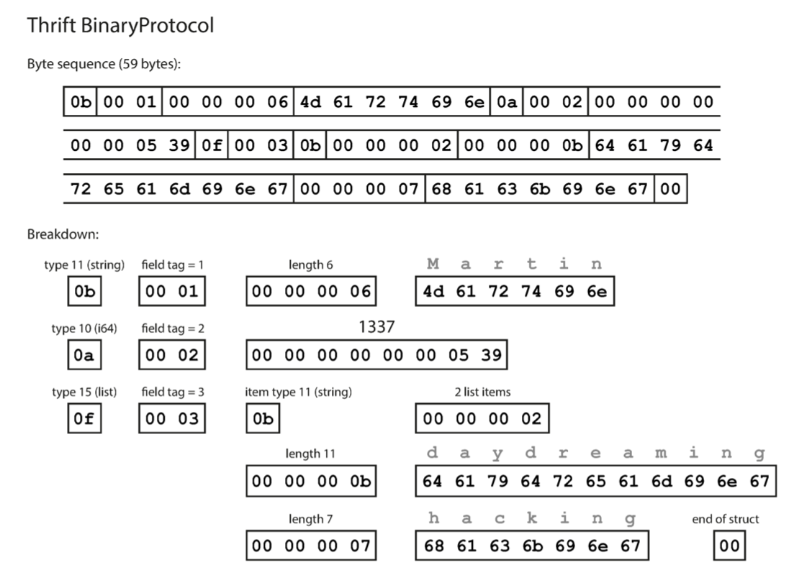
The BinaryProtocol of Thrift
Each field has:
Type annotation (1B)(类型声明，应该统一规定)
Type field (1B)(即schema中
提供的字段名对应编号)
A length indication (optional, required for string, list, etc.)
Data (like json)
For each type, the protocol assumes an internal encoding
E.g., little endian
Total 59B
no field names (userName, favoriteNumber, interests)

Slide 34
Being more compact: Thrift CompactProtocol
Techniques:
Packing field type & field tag in 1B(类似于Y86中对于指令类型的处理。)
Variable-length integer: top-bit of each byte indicates whether there are more bytes(用于声明当前byte后面是否还有额外的byte)
1
2

Slide 35
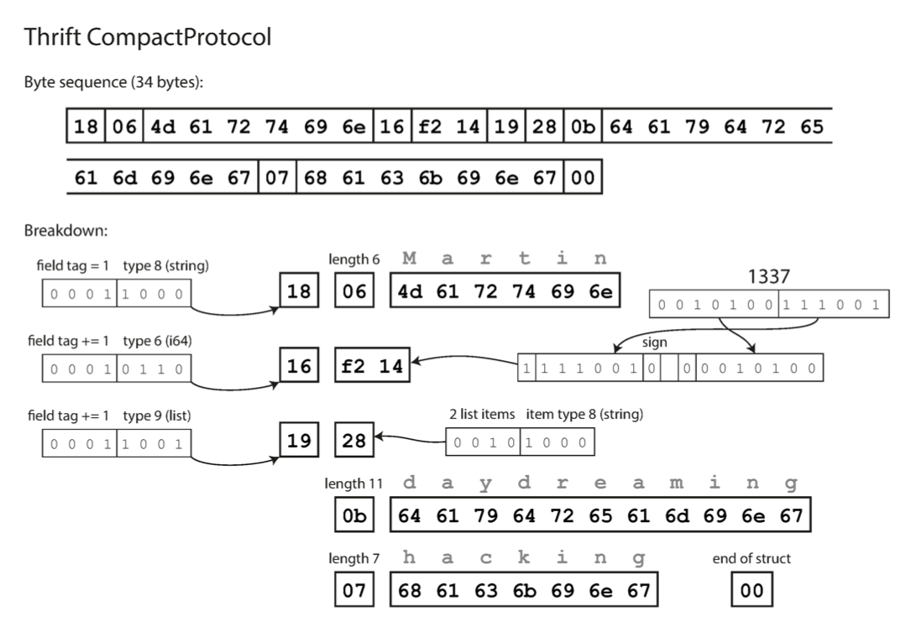
Being more compact: Thrift CompactProtocol
Techniques:
Packing field type & field tag in 1B
Variable-length integer: top-bit of each byte indicates whether there are more bytes 1337: from 8B to 2B
Now only consumes 34B

Slide 36
解释
对于上一页PPT中的1337的例子，其对应的第一个byte由top-bit(1 bit，声明后面还没有额外的byte)，数据(6-bit),符号位(sign-bit, 1-bit,用于声明正负).而对于后续的byte，不用再额外声明类型了，所以只有top-bit和数据(7-bits)。
这种存储方式，比较适用于长度远小于类型上限的数据。但是对于那些很长的数据由于需要额外的存储top-bit等额外信息，所以可能会浪费更多空间。
虽然从8B--2B，但是在server端解析的时候仍然要根据类型给他对应的空间。
对于length这种肯定大于0的数字，可以直接省去sign-bit，即每个byte都能存储7-bit数据。

Slide 37
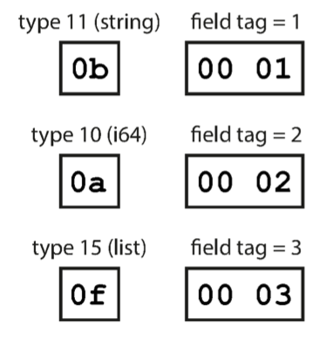
Schema simplifies supporting compatibility
Key observation: we only need to keep the field tags & field type compatible
Forward compatible: if new schema preserves the presentation of old schema, then new code can trivially decode the data encoded with old schema
Backward compatible: old code can simply skip fields with unknown field tag
只需要满足filed tag和field type能够在client端与server端兼容，
就可以认为CS是兼容的。(使用相同的IDL的情况下)

Slide 38
Short summary of parameter passing in RPC
Passing data using RPC is non-trivial, should ensure
Correctness
Compact
Evolvable
Encoding/decode
Convert an object into an array of bytes with enough annotation so that the decode procedure can convert it back into an object
Also known as marshal / unmarshal in RPC
With other names, e.g., serialize / unserialize

Slide 39
Automatic stub generation
Generate stubs from an interface specification
Tool to look at argument and return types
Generate the marshal and unmarshal code
Generate stub procedures
Benefits:
Saves programming (thus less error)
Ensures agreement on argument types
E.g., consistent function ID

Slide 40
Transport protocol of RPC
Stubs also include implementations of sending/receiving messages
TCP or UDP, which one to use?
What about new networking features, e.g., RDMA(remote direct memory access)?
Hide the transport protocol from the user
Benefits: e.g., transparent migrate to a more advanced network
Most support several
Allow programmer (or end user) to choose at runtime

Slide 41
Short summary: program distributed systems w/ RPC
RPC simplifies programming w/ an interface similar to local function call
RPC uses stubs to avoid handling argument encoding/decoding and send/receiving messages, etc.
Ensure correctness & efficiency
Remain challenges of RPC：
How to handle failure?
As we have mentioned, failure is common especially in large-scale distributed systems!

Slide 42
When RPC meets failure

Slide 43
When RPC meets failures
Local procedure calls do not fail (most of the time)
If that happens, the entire process usually dies
RPC may meet many different failures
Parameter error -> just return
Server crash -> how the client copes with it?

Slide 44
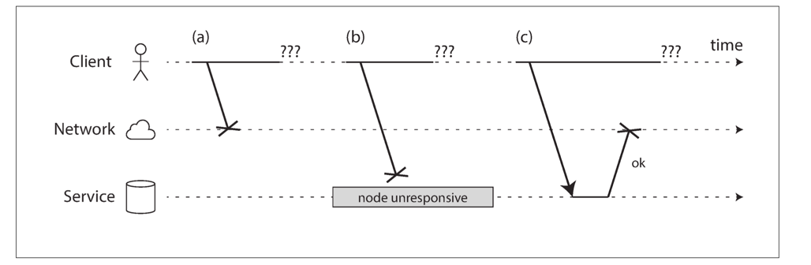
When RPC meets failures
RPC could fail in a partial failure way
Like what we have presented in lecture 02
A client uses RPC to call a function at a service through the network
The client does not get any reply
What could possibly happen?

Slide 45
When RPC meets failures
A user sends an RPC but the server does not reply, possible reasons:
1. Request may have been lost (e.g., someone unplugged a network cable).
2. Request may be waiting in a queue and will be delivered later (e.g., the network or the recipient is overloaded).
3. The remote node may have failed (e.g., it crashed or it was powered down).

Slide 46
When RPC meets failures
A user sends an RPC but the server does not reply, possible reasons:
4. The remote node may have temporarily stopped responding (e.g., it is experiencing a long garbage collection pause)
5. The remote node may have executed the function, but the response has been lost on the network (e.g., a network switch has been misconfigured).
6. The remote node may have executed the function, but the response has been delayed and will be delivered later (e.g., the network or your own machine is overloaded).

Slide 47
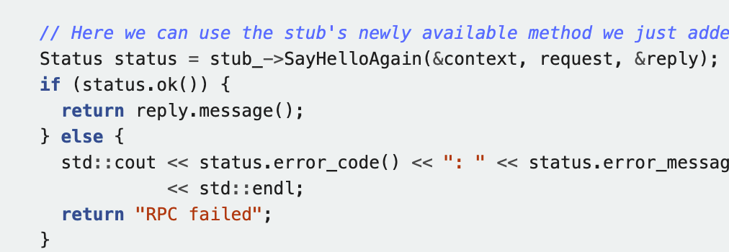
RPC != PC
The transparency of RPC breaks here:
Applications should be prepared to deal with RPC failure
E.g., gRPC will return a status for application to check

Slide 48
When RPC meets failures
Semantics of remote procedure calls
Local procedure call: Exactly once(即只发一次，无论成功与否)
A remote procedure call may be called:
0 time: server crashed or serve process died before executing server code
1 time: everything worked well, as expected
1 or more: excess latency or lost reply from server and client retransmission

Slide 49
RPC semantic
Most RPC systems will offer either:
At-least-once semantics
At-most-once semantics
Simple retransmission leads to "at-least-once"(至少一次，即使转发之后已经成功了还会继续发)
Birrell’s RPC semantics :
server says OK: executed once
server says CRASH: zero or one time
much easier than exactly once, more useful than at-least-once

Slide 50
RPC semantic
Understand application:
Idempotent:(幂等的) may be run any number of times without harm (e.g., i = 1)(即单用户重复执行多次状态相同)
Non-idempotent:(非幂等的) those with side-effects (e.g., i++)(即单用户重复执行多次后状态不同)
When at-least-once is OK?
if no side effects (e.g., read-only operation) (只读的情况下)
if app has its own plan for detecting duplication(app 有自己的去重功能)
还有别的方式：client记住所有请求的xid，在新情求发过来的时候判断对应xid是否已经存在，
若已经存在直接返回而不做额外的处理，若不存在则正常处理。

Slide 51



Cases of idempotence
“Idempotence means that multiple invocations of some work are identical to exactly one invocation.”
——Pat Helland
Sweeping the floor is idempotent
Pressing the elevator button is idempotent
Saving money is non-idempotent

Slide 52
Idempotence in RPC
RPC client
RPC server
Call(server, “ReadTime”);
ReadTime() {
return current_time;
}
Succ
C0
Failure & retry
Succ
C1
Server
ReadTime
ReadTime
ReadTime
Time

Slide 53
Idempotence in RPC
RPC client
RPC server
Expect ReadTime is called twice
Actually called 3 times
Is it ok? Why?
没问题，因为是幂等操作！
Call(server, “ReadTime”);
ReadTime() {
return current_time;
}
Succ
C0
Failure & retry
Succ
C1
Server
ReadTime
ReadTime
ReadTime
Time

Slide 54

Idempotence in RPC
RPC client
RPC server
Call(server, “Like”);
Like() {
counter++;
}
Succ
C0
Failure & retry
Succ
C1
Server
Like
Like
Like
counter=1
counter=2
counter=3
Time

Slide 55

Idempotence in RPC
RPC client
RPC server
Expect Like is called twice
Actually called 3 times
Is it ok? Why?不行
What about something like Vote?
Call(server, “Like”);
Like() {
counter++;
}
Succ
C0
Failure & retry
Succ
C1
Server
Like
Like
Like
counter=1
counter=2
counter=3
Time
Notes:
If it's vote, then the application needs to consider by itself: e.g., it can count the user name instead of using just a counter.

Slide 56
RPC semantic
Understand application:
Idempotent: may be run any number of times without harm
Non-idempotent: those with side-effects (e.g., call i++ at the server)
When at-least-once is OK?
If no side effect (e.g., read-only operation, ReadTime)
If app has its own plan for detecting duplication
E.g., record how many times a counter has been added

Slide 57
Ideal RPC Semantics: exactly-once
Like single-machine function call
Implement exactly-once semantics:
Server remembers the requests it has seen and replies to executed RPCs (need to across reboots)
Detect duplicates, requests need unique IDs (XIDs)
但是这种detect duplicates的方式也是会出现问题的。因为server空间有限，不可能存储
所有的xid，所以过一段时间一定就会清除旧的xid(过期)。所以与此相关的问题是如何
合理的设置xid的过期时间。

Slide 58
Idempotence in RPC
RPC client
RPC server
Call(server, “Like”);
Like(xid) {
if not see xid {
counter++;
}
}
Succ
C0
C0:#1
Failure & retry
Succ
C1
C1:#1
C1:#1
Server
Like
Like
Like
counter=1
counter=2
counter=2
Time

Slide 59
Ideal RPC Semantics: exactly-once
Like single-machine function call
Implement exactly-once semantics:
Server remember the requests it has seen and replies to executed RPCs (across reboots)
Detect duplicates, reqs need unique IDs (XIDs)
Assumption: failures are eventually repaired, and client retries forever
How to correctly recover from failure? See next lectures

Slide 60
Put it all together: RPC system components
1. Standards for wire format of RPC message and data types
2. Library of routines to marshal / unmarshal data
3. Stub generator, or RPC compiler, to produce "stubs"
For client: marshal arguments, call, wait, unmarshal reply
For server: unmarshal arguments, call real function, marshal reply

Slide 61
Put it all together: RPC system components
4. Server framework:
Dispatch each call message to correct server stub
Recall each called functions ,if provide at-most-once semantic or exactly-once semantic
5. Client framework:
Give each reply to correct waiting thread / callback
Retry if timeout or server crash
6. Binding: how does client find the right server?

